Slide 1
THE COMMON MAN
BANK LTD.
THIRD QUARTERLY CREDIT CARD EXPENDITURE FORECAST

Slide 2
Problem Statement:
To understand a general client-credit card expenditure pattern and understand their financial profile to generate new decisions.
Approach: Prediction of Credit Card expenditure for the month of July , August and September using predictive analytics and ML models. This is a regression problem.

Slide 3
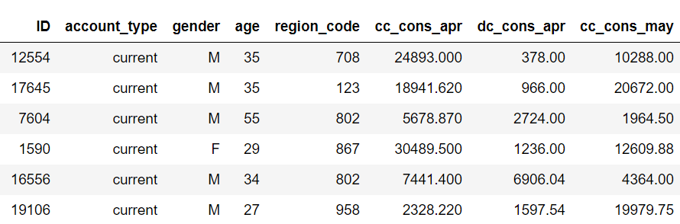
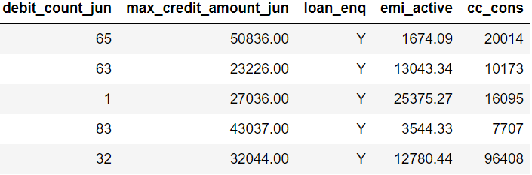
About the Data: The data consists of records of 15000 clients and 44 features. There are 43 predictors and 1 target that describes expect the average credit card expenditure of the client for the 3rd quarterly. Target Variable : cc_cons (Average Credit Card Spend in next three months)
Fig1:Sample screenshot of the dataset

Slide 4
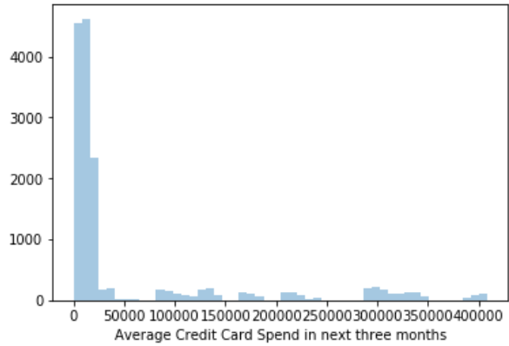
Target Variable : From the available data ,we have the expected amount of expenditure of our client base for the next 3 months.
Approx amount of 50k spent
by majority of population over
3 months.
The higher and lower values
of the range are :
4,08,382 and 5,341
respectively .
Fig 2(distplot)

Slide 5
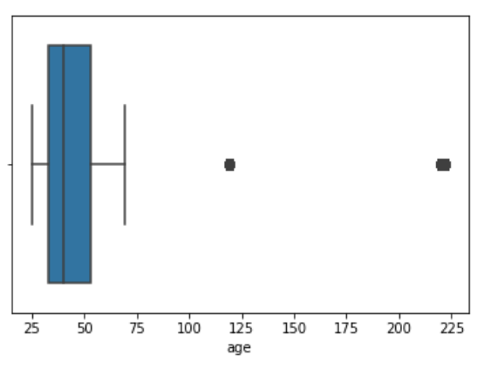
Fig 3 (boxplot of Age)
Age range of the client dataset ranges from 25 to 223 years
Maximum ages are between 25 to 55
Outliers are 125 and 223 for a very less percentage of population.
Feature moderation: dropped age greater than 120 since only 5 entries.
For ages greater than 70 we have replaced with the median value of the column which is 38 years.

Slide 6
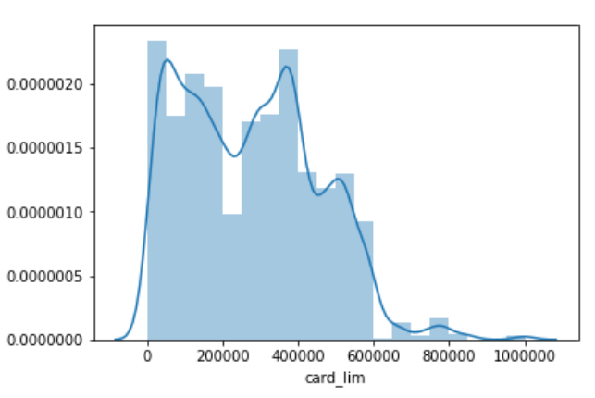
Details about the credit card limit set for the customers: Minimum limit: Rs. 10,000 Maximum limit :Rs. 10 L Maximum population have limit between a range of 10k to7 Lakhs Feature treatment : Removed zero values from the column.
Fig 4 (card_lim)

Slide 7
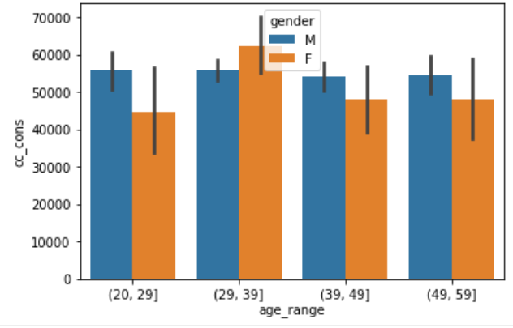
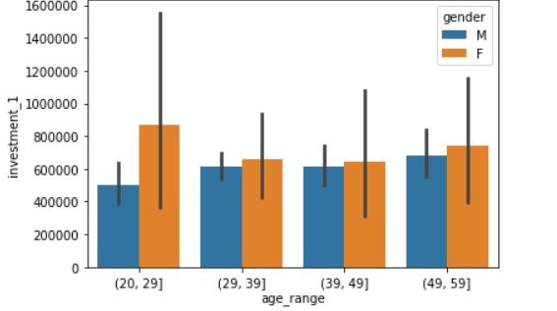
Continuing our Eda.. Correlation of Age with the expected CC amount spend for the clients:
Fig5
Fig 6 (For DEMAT acc.)
Observation:
Females majorly in their 30s :expected to spend most (maybe because of financial stability?
Or highly lucrative CC offers on various retail fronts?)
Males don’t show much deviation for the same.
Females in their 20s have made maximum investment in their DEMAT account so they are likely
to spend less in the subsequent months.

Slide 8
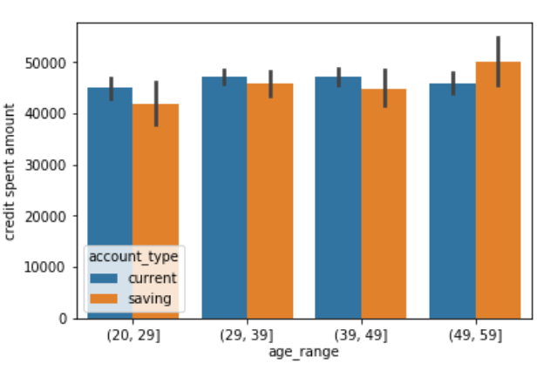
Do we have a trend for the client based on their type of account??
Observation:
Clients (in their 50s and having a savings type a/c) have spent the most using their CCs in
the past 3 months.
This shows expenditure increases with the age for people having savings a/c(salaried
Employees/having monthly income)
Traders/Entrepreneurs(who need to access their a/c Daily) having current a/c don’t
show much deviation.
(Can we lower the fees and interests charged on the overdraft facilty To motivate current a/c
Holders to spend more ?)

Slide 9
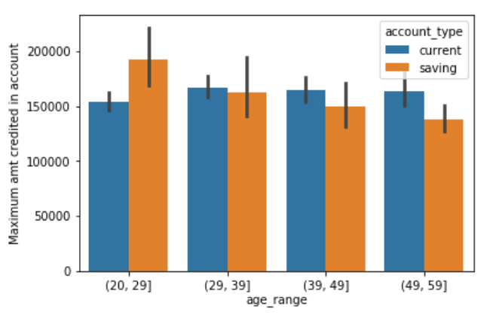
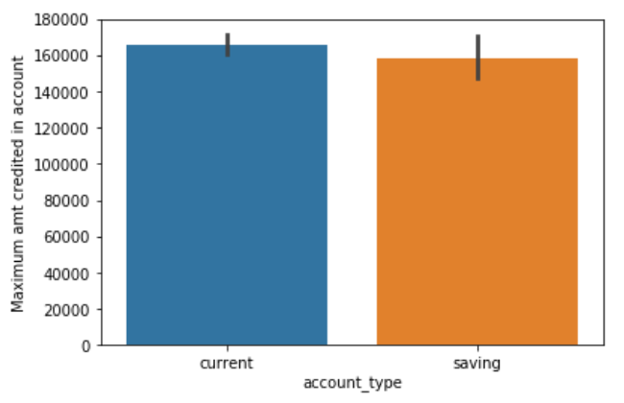
Steep decrease observed in the credited amount to a/c of clients with ‘savings’ type with increase in age range. Minimum deviation for the same for ‘current’ type a/c. Also there is overral increase in the amount credited for current a/c .
Age with max credit card spent and type of account

Slide 10
Credit card transaction exploration with respect to Region to find if any trend exists:
Region Code 424 has maximum amount of transaction of 11,61,694.11 with # of txn 95( Avg ~ 12,228)
Region Code 424 has minimum amount of transaction of 1544 with # of txn 192( Avg ~ 8)
Region Code 505 has minimum number of transactions using credit which is 3 , amount spent is 1,01,083( Avg ~ 33,694)
Region Code 713 has maximum number of transactions using credit card which is 1220 , amount spent is 66,735 (Avg ~ 55)
Clearly average of region 505 > average of region 424
which makes us largely presume that region 505 is most affluent of all.

Slide 11
Models and Approaches:
One base model was assessed without performing any hyper parameter
tuning and without treatment of outliers.
The model was - Linear Regression
RMSLE(root mean squared logarithmic error) is 7.44.
R2_score is -0.314 (worse than the mean )

Slide 12
Pipeline:
Missing values:
There were no missing values in the entire dataset.
Outlier Treatment: Calculated the IQR score for the outliers of entire dataset.
Which resulted in better score of our chosen model(i.e. Linear Regression)
Feature selection:
Correlation method Dataframe.corrwith() used for feature selection. Region code is least correlated and cc_cons_may is most correlated with the target.
Features dropped: "ID","personal_loan_active","vehicle_loan_active","personal_loan_closed","vehicle_loan_closed“

Slide 13
Model tuning: After outlier treatment and feature selection, the following results were obtained :
Modelling method | RMSLE score
Linear regression | 2.05
Logistic regression | 2.18
Random Forrest Classifier | 2.92
Linear SVC | 2.1
AdaBoostRegressor | 2.39
Model selected: Linear regression

Slide 14
Insights & decision
Customers to be targeted:
Age Range:30-50 years
Can Pitch high end offers to the affluent regions
Provide in depth analysis and stock recommendation from expert analysts.
Motivate clients of 30s age group to open DEMAT using their saving a/c

Slide 15
Next steps for more optimised model:
To perform better feature engineering.
To perform hyper-parameter tuning to optimize the model and minimize the loss function.
To build an automated ML UI for real time data.
Ensemble of different models.

Slide 16
Thank you!

